Slide 1
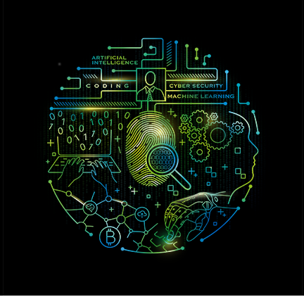
CGC_REBOUNDER Team member Bhawna Rajput(Captain) Himanshu Kumar Surendra Singh Hada

Slide 2
Content

Slide 3
Transportation for running the vehicles.
In power stations where diesel is used to produce electricity.
For smooth running of machines, in which lubricating oil is used.
For domestic and lightning purposes in which kerosene is used.
For the construction of metal roads in which tar is used.
For the manufacturing of candles and pharmaceuticals in which paraffin and Vaseline are used.

Slide 4
When you ask them to fill petrol for Rs 1,000 , the attendant fills up the oil only for Rs 200 . When you ask him why he didnt fill up for Rs 1,000 . He will give a innocent smile and say that he heard Rs 200 and he will fill remaining Rs 800 , he resets the meter and fills up another Rs 800 petrol and you pay Rs 1,000 (200+800).
Whats the scam here ? The problem is that he never resets the meter to 0 , he continues from the Rs 200 point itself and go till Rs 800 , so in reality you only get the petrol worth Rs 800, but pay Rs 1,000 . The trick here is that when he says that he is resetting the meter to 0 and moves towards it, at that some moment, another team mate of attendant will disturb you with some question like – “Sir, Cash or Card?” , or “Sir, PUC karana hai kya?” , Or “Sir can you fill up this coupon ?” .
As a human tendency – you will have to look at him or hear him and in those 3-4 seconds , the main attendent will start the meter again and by the time you look at the meter, its somewhere near 300-400 , and you feel that the meter has restarted starting from 0 , but actually it was just continued from 200 point only. So you loose Rs 200 here.

Slide 5
Oil minister Dharmendra Pradhan on Monday ordered an inspection of all petrol pumps in Uttar Pradesh and random checks elsewhere to detect short-selling of petrol and diesel by tampering with the system in dispensing units. The move comes after the Uttar Pradesh Special Task Force (STF) conducted raids on 11 petrol pumps in the state and discovered the alleged stealing of 50ml of fuel in every litre dispensed to customers.

Slide 6
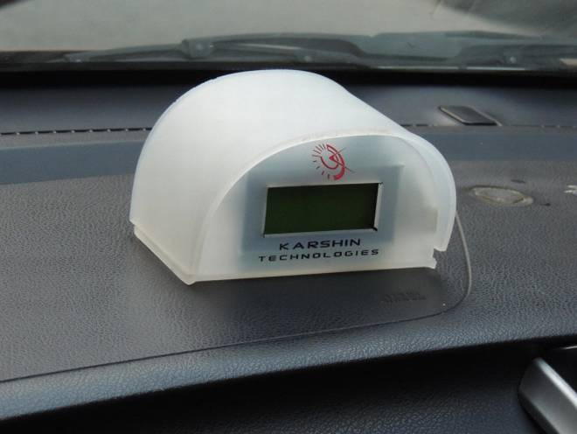

The appliance has a display screen and when installed in a vehicle records the exact quantity of fuel filled during each refill and even records the data for future reference. Analog fuel meters used currently in vehicles only give a rough estimate of the fuel present, says Sankalp, adding that this helps some petrol pump attendants to hoodwink customers. Also, the analog meters give no idea about the amount of fuel present when in reserve mode.

